Slide 1
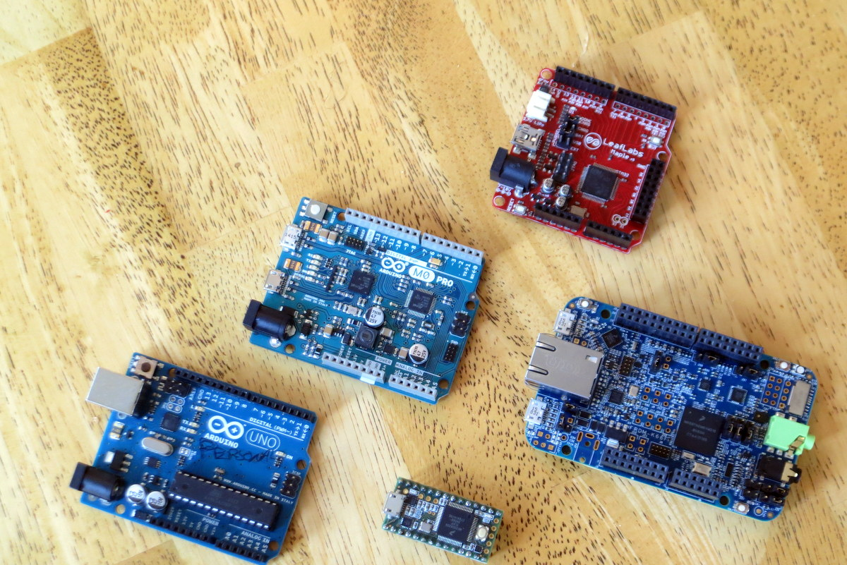
Go FFT!

Slide 2
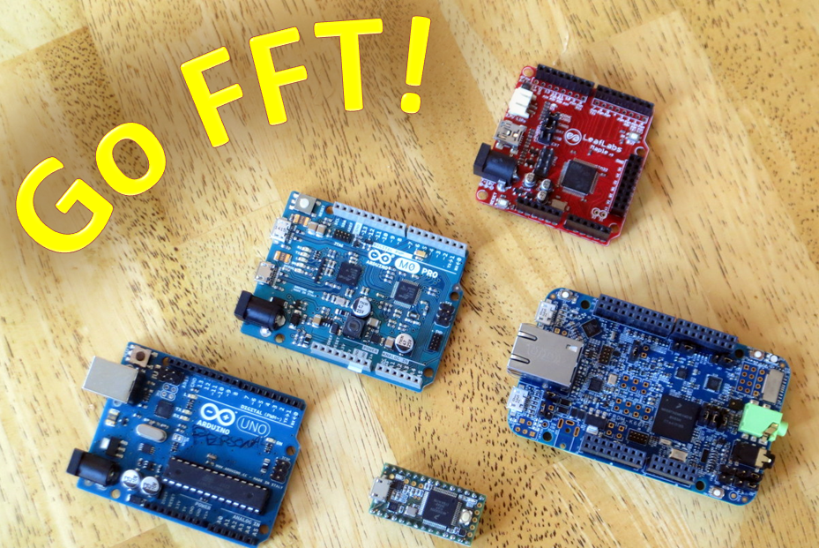

Slide 3
Go FFT!

Slide 4
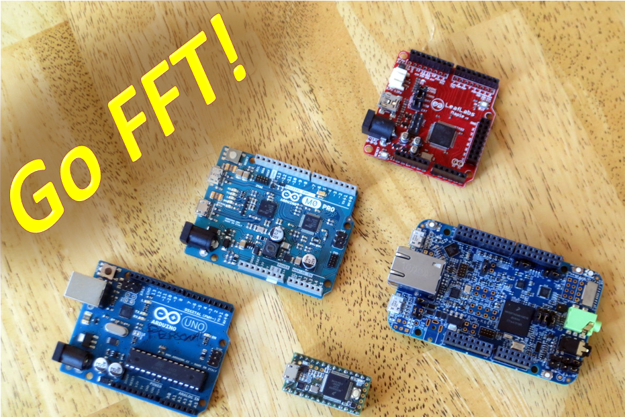

Slide 5
Board |  | Microcontroller
Brand | Model | Brand | Model | Core | Clock | Width | FPU | RAM
Arduino | Uno | Atmel | MEGA328P | AVR | 16 MHz | 8-bit | No | 2 KB
Arduino | M0 PRO | Atmel | SAMD21G18 | ARM Cortex-M0+ | 48 MHz | 32-bit | No | 32 KB
LeafLabs | Maple | STM | STM32F103 | ARM Cortex-M3 | 72 MHz | 32-bit | No | 20 KB
PJRC | Teensy 3.2 | NXP | MK20DX256 | ARM Cortex-M4 | 96 MHz | 32-bit | No | 64 KB
NXP | FRDM-K66F | NXP | MK66FN2M0 | ARM Cortex-M4F | 180 MHz | 32-bit | Yes | 256 KB

Slide 6
 |  | FFTs Per Second (More Is Faster)
Inputs |  | Generic C |  |  |  |  | CMSIS
N | Data | Arduino Uno | Arduino M0 | Maple | Teensy 3.2 | FRDM-K66F | Teensy 3.2 | FRDM-K66F
32 | Int16 | 201 | 3,127 | 8,052 | 9,671 | 14,493 | 30,864 | 58,824
64 | Int16 | 99 | 1,594 | 4,230 | 4,892 | 7,353 | 16,529 | 33,333
128 | Int16 | * | 639 | 1,644 | 1,922 | 2,865 | 7,156 | 14,286
256 | Int16 | * | 325 | 854 | 970 | 1,458 | 3,669 | 7,353
512 | Int16 | * | 135 | * | 399 | 594 | 1,575 | 3,226
 |  | FFTs Per Second (More Is Faster)
Inputs |  | Generic C |  |  |  |  | CMSIS
N | Data | Arduino Uno | Arduino M0 | Maple | Teensy 3.2 | FRDM-K66F | Teensy 3.2 | FRDM-K66F
32 | Int32 | 80 | 1,247 | 5,230 | 5,187 | 9,804 | 16,474 | 31,250
64 | Int32 | * | 597 | 2,714 | 2,607 | 5,263 | 8,578 | 16,667
128 | Int32 | * | 236 | 1,031 | 1,007 | 1,953 | 3,293 | 6,211
256 | Int32 | * | 114 | 531 | 506 | 1,031 | 1,675 | 3,155
512 | Int32 | * | 47 | * | 206 | 406 | 677 | 1,272
 |  | FFTs Per Second (More Is Faster)
Inputs |  | Generic C |  |  |  |  | CMSIS
N | Data | Arduino Uno | Arduino M0 | Maple | Teensy 3.2 | FRDM-K66F | Teensy 3.2 | FRDM-K66F
32 | Float32 | 157 | 457 | 1,499 | 2,015 | 21,277 | 3,542 | 40,000
64 | Float32 | * | 199 | 649 | 880 | 12,658 | 1,811 | 21,277
128 | Float32 | * | 81 | 263 | 351 | 4,608 | 658 | 9,524
256 | Float32 | * | 37 | 117 | 159 | 2,695 | 331 | 4,878
512 | Float32 | * | 16 | * | 67 | 1,019 | 130 | 2,123
* Insufficient RAM

Slide 7
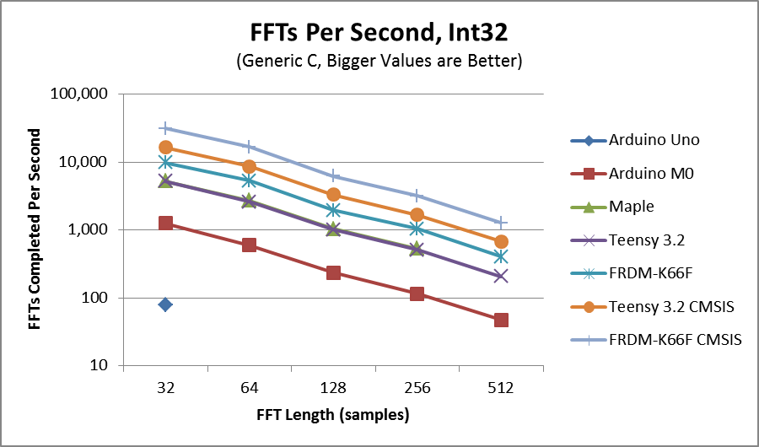

Slide 8
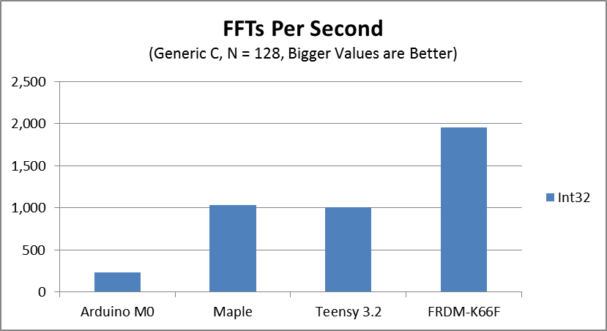
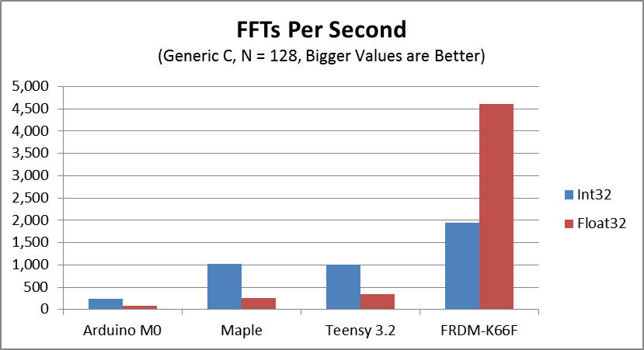

Slide 9
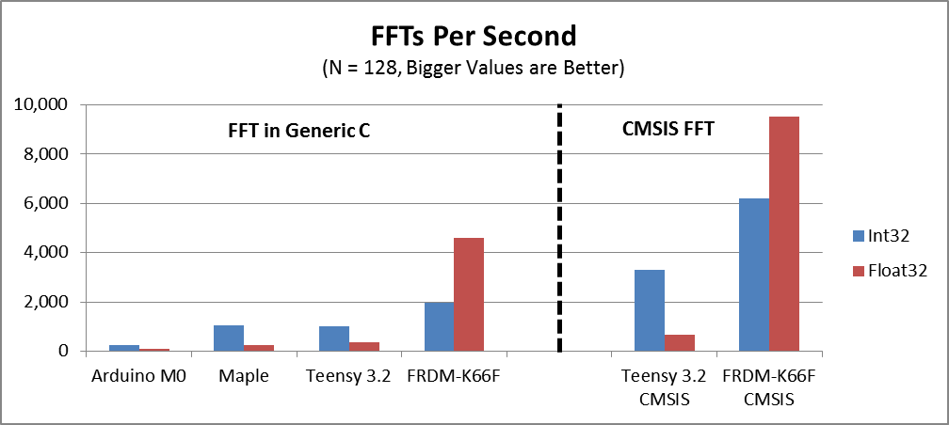

Slide 10
 |  | Max Sample Rate (Hz) for FFT+IFFT with 50% Overlap (Bigger is Better)
Inputs |  | Generic C |  |  |  |  | CMSIS
N | Data | Arduino Uno | Arduino M0 | Maple | Teensy 3.2 | FRDM-K66F | Teensy 3.2 | FRDM-K66F
128 | Int16 | * | 20,447 | 52,597 | 61,491 | 91,691 | 228,997 | 457,143
128 | Int32 | * | 7,545 | 33,003 | 32,219 | 62,500 | 105,367 | 198,758
128 | Float32 | * | 2,599 | 8,407 | 11,229 | 147,465 | 21,042 | 304,762
* Insufficient RAM

Slide 11
Speedup in FFT Due to CMSIS
Data | Teensy 3.2 | FRDM-K66F
Int16 | 3.7x | 5.0x
Int32 | 3.3x | 3.2x
Float32 | 1.9x | 2.1x

